Slide 1

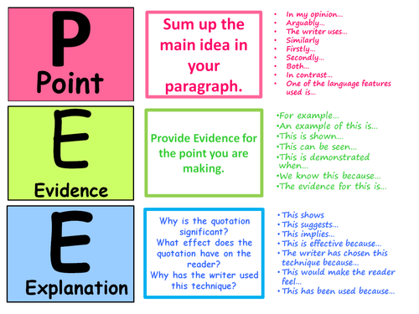
Unit 1A PPE
Introduction to RE
Sept – Dec 2018

Slide 2
RE KS3 exam style structure
See below the structure of the exam questions.
You will get four exam questions from each of the four sections below
3 Marks
I wrote THREE sentences using “Firstly”, “Secondly” and “Thirdly”.
12 Marks + 3 SPAG total= 15 marks
I wrote two PEE paragraphs (“This is because” and “for example”) by starting with “Some think” and “Some also think” to support the quote. I used a Religious view and looked at what holy books, teachings or founders had to say on the matter.
I wrote two middle PEE paragraph’s (“This is because” and “for example”) by starting with “Others think” and “Others also think” to disagree with the quote. I used a Religious view and looked at what holy books, teachings or founders had to say on the matter.
I gave a well justified conclusion about which argument is stronger.
4 Marks
I wrote ONE point and developed it using an explanation OR example (“This is because” or “for example”)
I wrote a SECOND reason and developed it using an explanation OR example
I used key words that I learnt in lesson about this topic.
5 Marks
I wrote ONE reason and developed it using PEE (“This is because” and “for example”)
I wrote a SECOND reason and developed it using PEE (“This is because” and “for example”)
I wrote Holy book quotes to back up my statements OR I wrote about what a religious leader/ founder view on the matter.
I used key words that I learnt in lesson about this topic.

Slide 3
1 Title- Why do we need to do RE in LEA VALLEY Academy?
Meaning
A system of faith and worship. It is also the belief and worship in a of a God or a group of Gods.
(Oxford Dictionary 2013)
We develop communication skills; learn new ideas about questions like “What is right and what is wrong?” and “Is there a purpose to my life?”
RS helps us to develop skills of debate of arguing for and against.
RS Should NOT be taught at schools | RS SHOULD be taught at schools
52% of the UK is atheist. We should consider the majority. | UK is a diverse country with people of different beliefs and faiths. We need to understand these differences.
RS forces children to become more religious. | RS is about more than simply teaching religion.
RS asks questions that can never be answered, so there is no point. | RS helps us think and enquire about BIG questions about life, death, God.
Religious people have caused war and conflict (E.g Bin Laden). | In RS we learn about inspirational people (Martin Luther King, Gandhi).
In today’s world making money is more important. RS doesn’t teach the value of profit-making. | RS helps us to be more tolerant and less prejudice towards people of different beliefs. These are also important values.
The UK is mostly a Christian country, so why learn about other religions. | We need to learn about other religions in order to be less offensive and more tolerant
RS also helps us to challenge other people who want to destroy our society and make links with current affairs (Isis, terrorism, Immigration and racism)
We think about the kind of world we want to live in and be a part of.
We learn about major
religions of the world (Hinduism, Judaism,
Buddhism, Christianity, Islam, and Sikhism) .
We ask big questions like “What happens when we die?” and “What is the purpose of life”?
We learn what
people believe about God.

Slide 4
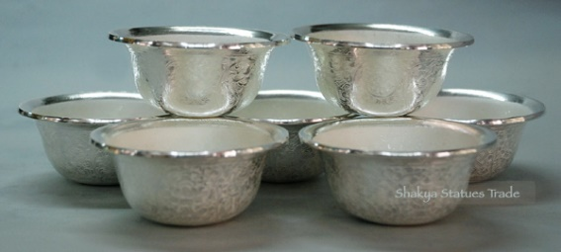
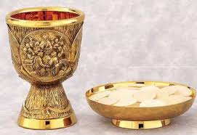
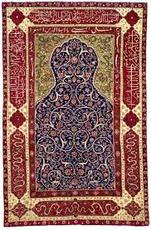
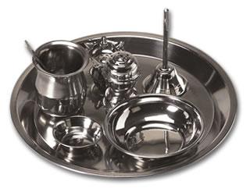
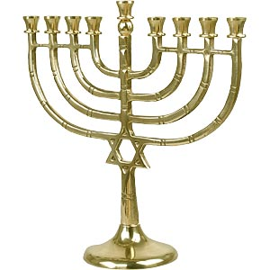
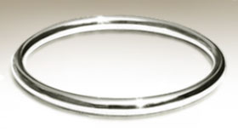
4 Title- Why do we need religious objects?
Communication with God
Show respect to God
To help with worship
Meaning
SYMBOLIC ARTICLES OR “ARTEFACTS”
Religious people use special symbolic objects called “artefacts” to help them understand something which they believe about God. To the non-religious person, they appear as physical things, but to the religious person, they are much more.
Offering Bowls: As part of their worship or meditation ritual Buddhists may place offerings in a bowl which is placed in front of a shrine. Offerings may include water, rice, flowers, fruit, and money.
Chalice and Paten : Cup and plate used in Holy Communion a Christian ceremony where the bread (Jesus body) and Wine (Jesus blood) are placed.
Each shrine will also contain a puja tray which holds some seven items. These items are used in the worship. They help the Hindu to use all their senses when they worship, as a symbol that the whole person is taken up with the worship. These items include incense sticks, candles and food.
Prayer Mat - Preparation for prayer within Islam includes ritual washing and finding a clean place on which to pray. Prayer mats are used for this purpose. They are usually richly decorated.
Kara (Iron bracelet) – This bracelet reminds Sikhs that life is never ending and they must wear this at all times. It is also a reminder to Sikhs that whatever they do with their hands it must fall in with Sikh rules.
A menorah is a lamp stand that represents God’s eternal presence. It usually has 7 lamps but a Hanukah lamp has 9.

Slide 5
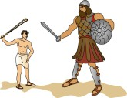
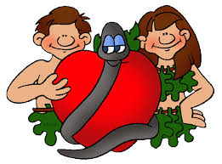
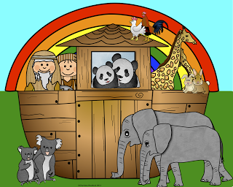
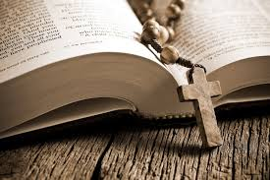
What are the similarities/differences between the Bible and Qu’ran? (Look at next slide)
5 Title- How do sacred texts (Holy Booksl) affect believers lives?
The Bible
What the Bible contains
Laws and Instructions | This refers to parts of the Bible which tell us how we should behave and what laws we should live by.
Parable | A parable is a story told to help us understand an important point.
Prophecy and Revelation | In the Bible there are people who are given visions of the future or important messages by God. Those people are called prophets; a revelation is something that has been revealed to them.
Poetry and Songs | In the Bible there are many songs and poems written to, or about, God as a way of praising him.
Proverbs | These are short, sometimes funny, comments on human life and our manners.
History | Many parts of the Bible talk about historical people and events, including the actions of famous kings such as King David and King Solomon.
Prayers | People recorded prayer in the Bible because it was as important then as it is now.
The Bible is no ordinary book. It tells the stories of thousands of characters, covers thousands of years of history and is the best selling book of all time. In the Old Testament you can find 39 books, and 27 books in the New Testament. Each book tells a story and has its own style.
God knew that humans are vastly different to each other in their interests and outlook, so he used all sorts of people, with a wide variety of gifts, to convey his message to mankind.
All the famous stories
You probably know many Biblical stories from childhood, such as Adam and Eve (Genesis 3: 1-20), Noah’s Ark (Genesis 7:1), Joseph and his dream coat (Genesis 37:3), Moses and the Ten Commandments (Exodus 20 1-17) and David and Goliath (1 Samuel 17:41-51).
Famous sayings
Lots of sayings that we know well began in the Bible. Match up these sayings with where they come from in the Bible. You’ll be surprised how much we still use parts of the Bible in everyday conversation! (some of the words might be slightly different according to what translation you use!)
Job 19:20 | An eye for an eye and a tooth for a tooth
Exodus 21:24 | A man after one’s own heart
Ecclesiastes 8:15 | Escape by the skin of one’s teeth
Proverbs 16:18 | Pride goes before a fall
Isaiah 57:21 | A law unto oneself
1 Samuel 13:14 | Eat, drink and be merry
Romans 2:14 | There is no peace for the wicked
Notes:
Top set

Slide 6
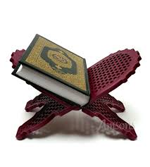
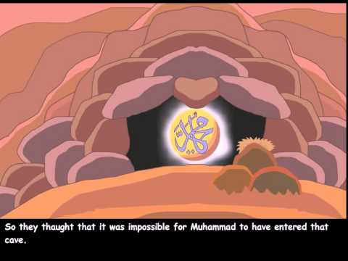
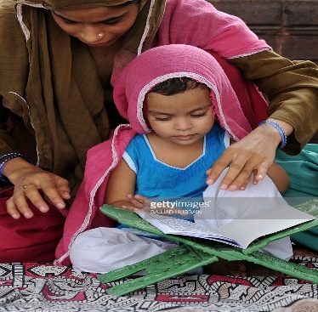
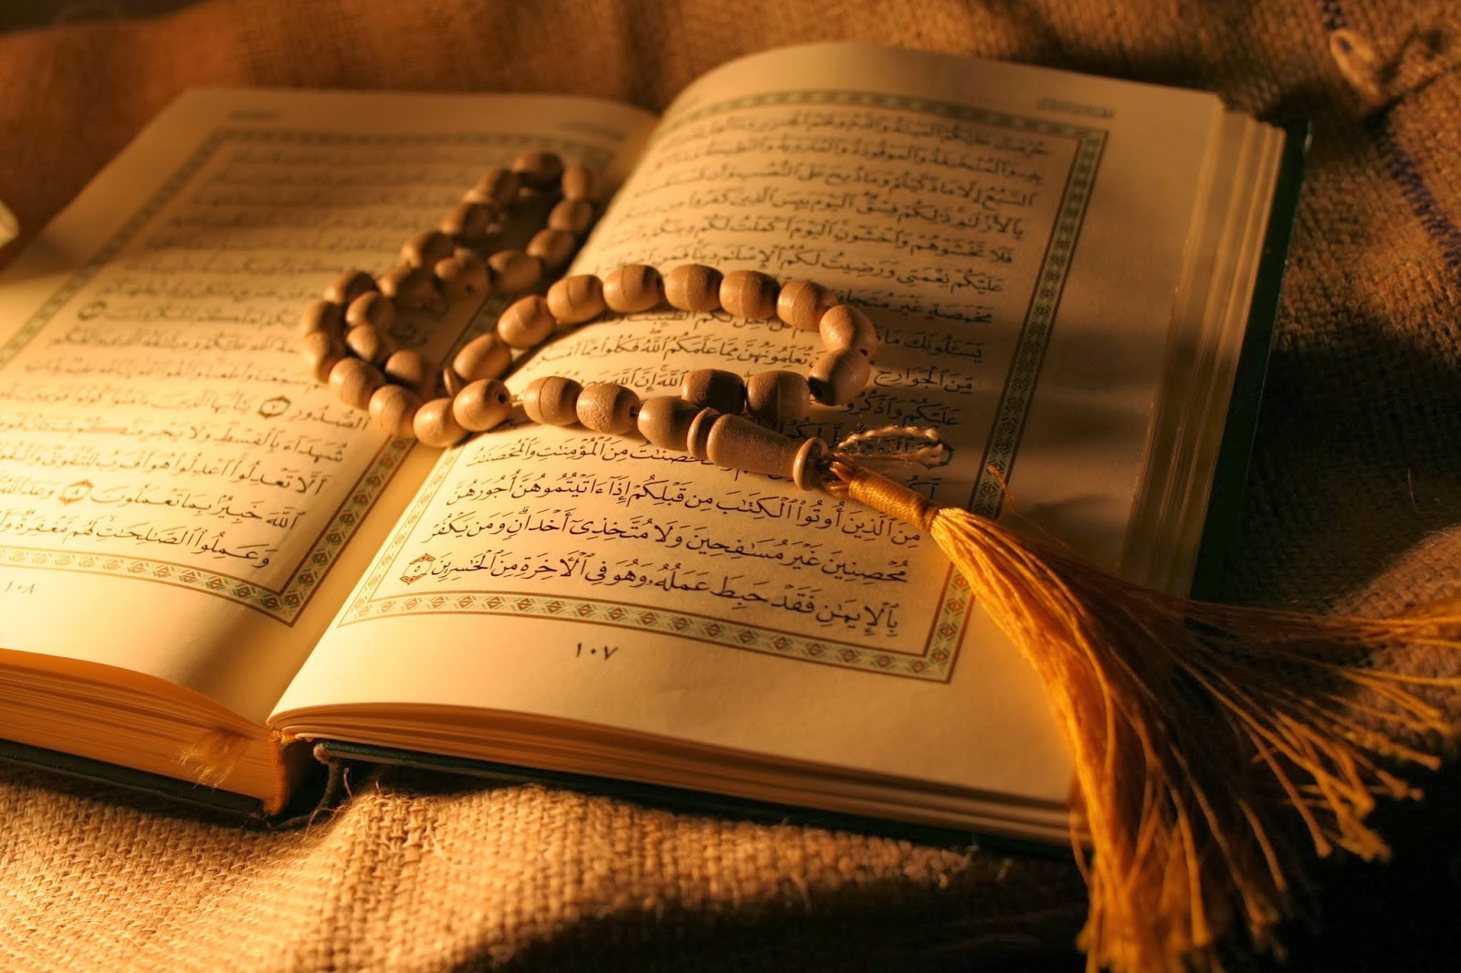
The Qu’ran
5 Title- How do sacred texts affect believers lives?
In the year 610ce, Muhammad (the founder of Islam) saw an angel whilst praying in a cave. The angel said, “Read in the name of your Lord who created you”! Muhammad was terrified and said, ‘I cant read’. Three times the angel told him to read, and eventually, Muhammad found he could recite the words the angel told him.
Muslims believe that the Qu’ran contains the exact words of God.
Muslims who want to know precisely what God intends learn to read in Arabic as the Qu’ran is in Arabic.
Over the next 23 years, Muhammad received many visits from the angel with messages. He learnt each one by heart carefully, then told his close friends who wrote them down. After the final messages, the writings were out together in a book called the Qu’ran. ’Qu’ran’ means ’recitation’ because that was how Muhammad learnt it.
The book is always kept off the floor and often read on a little stand. When it is stored, the book is wrapped in material and kept on a high shelf.
What are the similarities/differences between the the Bible and Qu’ran? (Look at next slide)
The Quran has rules and laws written in it about believing In one God, prayer, charity, fasting, what types of food are and are not allowed to be eaten.
It explains about marriage, divorce, buying and selling, crimes and punishments and many more.
Muhammad explained to his followers that the book God had given them contained everything that was essential for life. It stated they should worship only one God and gives them a set of rules for daily life. Muslim children are taught it from a very young age by their mosques and parents.
Notes:
Bottom set

Slide 7
6 Title- Is there a God?
Meanings
Atheist- no belief in God
Theist- belief in God
Agnostic- not sure if God exists.
Atheism | Agnostic | Theist
There is no proof that God exists. | Not sure if you need proof, but doesn’t have complete faith either. | You don’t need proof to believe that something is true (faith).
Science explains the creation of the universe (the Big Bang), so God didn’t create the world. | It might be possible to believe in God and agree with science – not sure. | God created the world-, there is too much beauty in the design of the universe (planets, food chain, water cycle, photosynthesis, animals etc.) .
There is no such thing as miracles, these are only coincidences. | Agrees that miracles can happen, but unsure why. | God(s) does exist because prayers are answered everyday and miracles happen.
Religious holy books were written by humans and the stories are not true with many being only myths. | Religious texts may still contain truth but may not be inspired by god(s). | Holy books inspired by god(s) with many people in there that did exist such as Muhammad and Jesus as there is historical proof they did.

